Slide 1
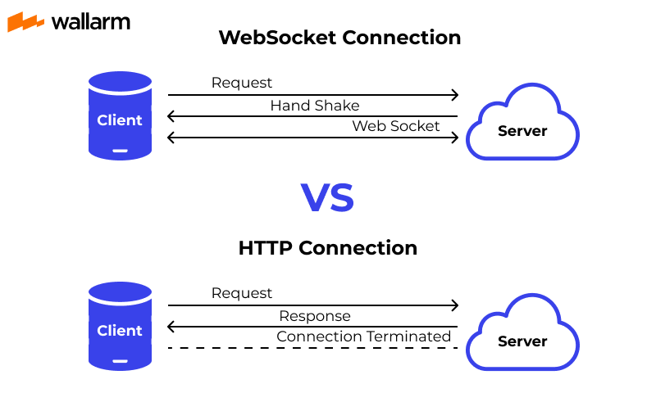
HTTP VS WebSocket

Slide 2
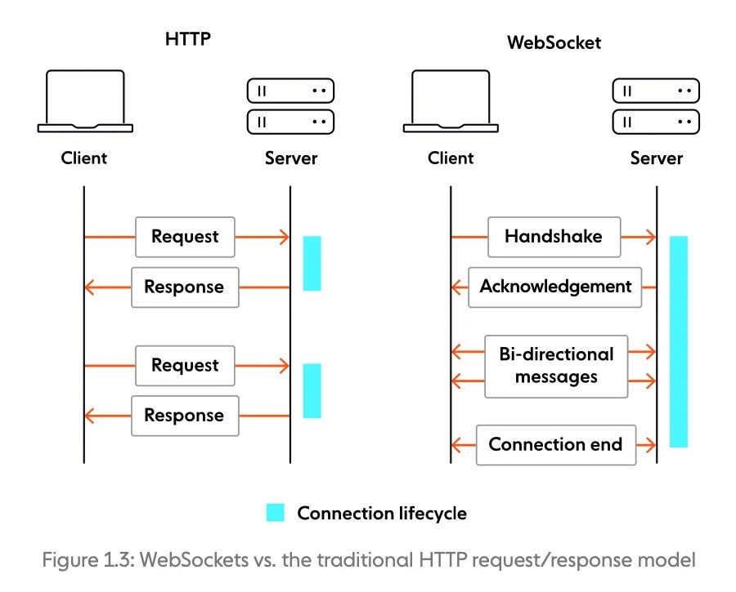
HTTP VS WebSocket

Slide 3
Create WebSocket Connection
Create HTTP Connection
Upgrade into webSocket
const http = require("http");
const app = express();
const server = http.createServer(app);
const { Server } = require("socket.io");
const io = new Server(server);
After Upgrade, IO Contain the webSocket Connection

Slide 4
Build relationship with the client and server
From client side
In server side
import { io } from "socket.io-client";
const socket = io("http://localhost:3000");
export default socket;
io.on("connection", (socket) => {
console.log(`User connected: ${socket.id}`);
});

Slide 5
Socket.io Function
Server side
Client side
io.on(event, callback)
Listens for a specific event from the client.
socket.emit(event, data)
Sends a custom event to the connected client only.
io.on('RoomId', (userID) => {
console.log('A user connected');
});
socket.emit('RoomId', userID);
socket.broadcast.emit(event, data)
Sends a message to all clients except the sender.
socket.broadcast.emit('user joined', 'A new user has joined');

Slide 6
Typing Race Application Workflow
Join Race
Join
In this phase users can join the event for participate the typing rate.
Ready
Preparing
Wait for all player be prepare and press the ready button
Start Race
Start
After race start all user can see the real time race progress of other player.
Winner
Jupiter
Whoever complete the exact given text first will be winner.

Slide 7
🧑‍🤝‍🧑 1. Join Race
Client Side Request:
Server Side:
socket.emit("join", playerName);
socket.on("join", (name) => {
socket.data.name = name;
if (!participants.includes(name)) {
participants.push(name);
progressMap[name] = 0;
readyStatusMap[name] = false;
io.emit("user-joined", participants);
io.emit("ready-status", readyStatusMap);
}
});
Client Side Listener:
socket.on("user-joined", setParticipants);
🔹 User joins the game lobby and is added to the participants list.

Slide 8
✅ 2. Ready Up
Client Side:
Server Side:
socket.emit("request-start", playerName);
socket.on("request-start", (name) => {
if (!readyToStart.includes(name)) {
readyToStart.push(name);
readyStatusMap[name] = true;
}
io.emit("ready-status", readyStatusMap);
if (readyToStart.length === participants.length && !countdownStarted) {
countdownStarted = true;
io.emit("start-countdown");
}
});
Client Side Listener:
socket.on("ready-status", setReadyStatus);
socket.on("start-countdown", () => {
let count = 3;
setCountdown(count);
});
🔹 Player signals readiness to start the race. Countdown starts when all are ready.

Slide 9
⏱️ 3. Countdown & Start Race
Client Side:
Server Side:
socket.on("start-countdown", () => {
// Countdown from 3, then:
socket.emit("start-race");
});
socket.on("start-race", () => {
currentSentence = getRandomSentence();
winnerDeclared = false;
Object.keys(progressMap).forEach(name => progressMap[name] = 0);
readyToStart = [];
Object.keys(readyStatusMap).forEach(name => readyStatusMap[name] = false);
countdownStarted = false;
io.emit("ready-status", readyStatusMap);
io.emit("start-typing", currentSentence);
});
Client Side Listener:
socket.on("ready-status", setReadyStatus);
socket.on("start-typing", (sentence) => {
setTypingSentence(sentence);
});
🔹 Countdown begins and a random sentence is sent to all players to begin typing.

Slide 10
⌨️ 4. Typing Progress
Client Side:
Server Side:
socket.emit("typing-progress", { name, typed });
socket.on("typing-progress", ({ name, typed }) => {
if (!winnerDeclared) {
progressMap[name] = typed.length;
io.emit("update-progress", progressMap);
if (typed === currentSentence) {
winnerDeclared = true;
io.emit("race-complete", name);
}
}
});
Client Side Listener:
socket.on("update-progress", setProgress);
socket.on("race-complete", (winnerName) => {
setWinner(winnerName);
setRaceStarted(false);
});
🔹 Players type the sentence and send live progress updates to the server.

Slide 11
🏆 5. Race Complete
Client Side (Listener):
socket.on("race-complete", (winnerName) => {
setWinner(winnerName);
setRaceStarted(false);
setCelebrationVisible(true);
});
🔹 First player to complete the sentence wins. Race ends and winner is announced.

